Slide 1

Version 3
Version 2 fixes
Data Base
Bid – Ask
External systems
Robustness
Configuration files

Slide 2

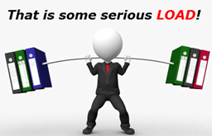
Load and stress problems
Load and Stress system problems are both subsets of the system performance.
Performance is the response time, speed, scalability and the resource utilization of the software and infrastructure.
load problems is the situation of the system under peak traffic conditions when a lot of users asking to the same resources at the same time.
the load problems is depending also in the system hardware.
stress problems is the situation of the system behavior beyond peak conditions and the response of the system when it is returning to normal load conditions.

Slide 3
Load & Stress Tests
load problems is the situation of the system under peak traffic conditions when a lot of users asking to the same resources at the same time.
stress testing is used to test the system behavior beyond peak conditions and the response of the system when it is returning to normal load conditions.

Slide 4
Load & Stress Tests
From load and Stress tests we get the behavior of our system in the unconventional situations, i.e. loads and various end cases as we explained earlier.
Through information on these cases, it is possible to improve the system in a specific and accurate way to be load and stress resistant.
The improves may be in the software field or/and in the hardware field or/and in the infrastructure field..

Slide 5
Load & Stress tests VS. Unit & acceptance tests
Unit tests and acceptance tests refer to the logical behavior of the system. Does it meet customer requirements and do the functions perform what is required of them. They are performed under very low system load using a few individual users.
Therefore, acceptance tests and unit tests do not cover load and stress cases, and cases of unwanted system failures and exceptional end cases.
Memory management, memory leaks, bugs, buffer overflows, etc.
Make sure that the system has saved the data before crashing or not.

Slide 6

Load & Stress tests tool

Slide 7
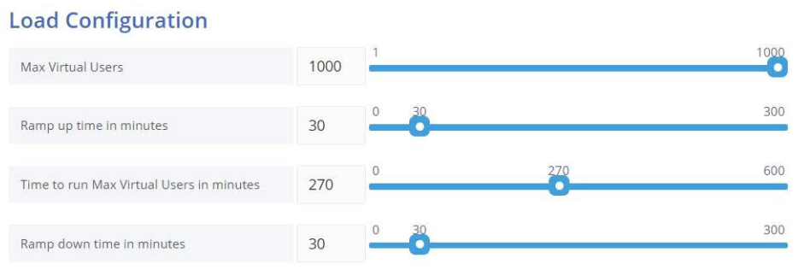

Slide 8
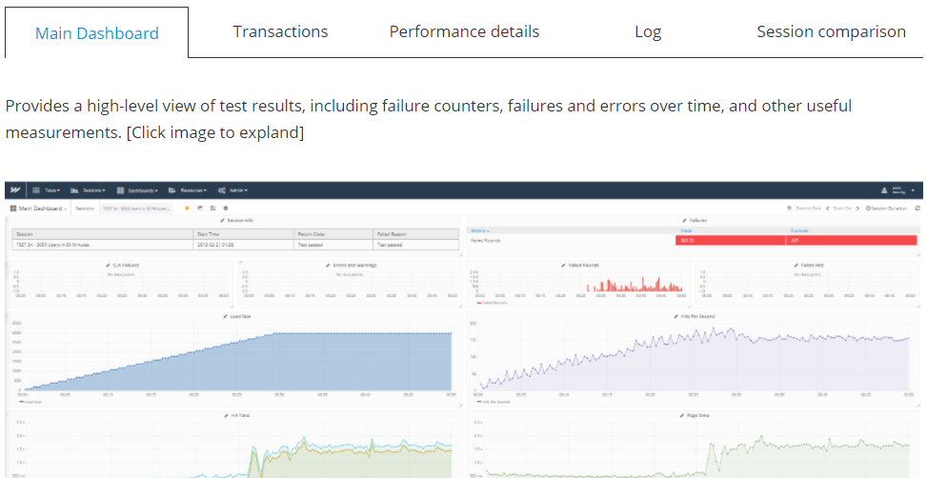

Slide 9
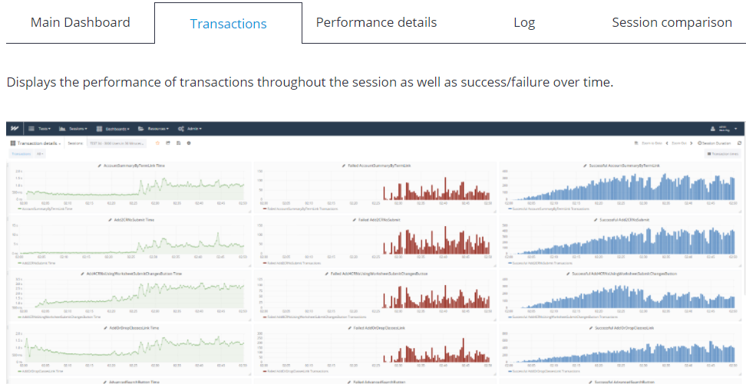

Slide 10
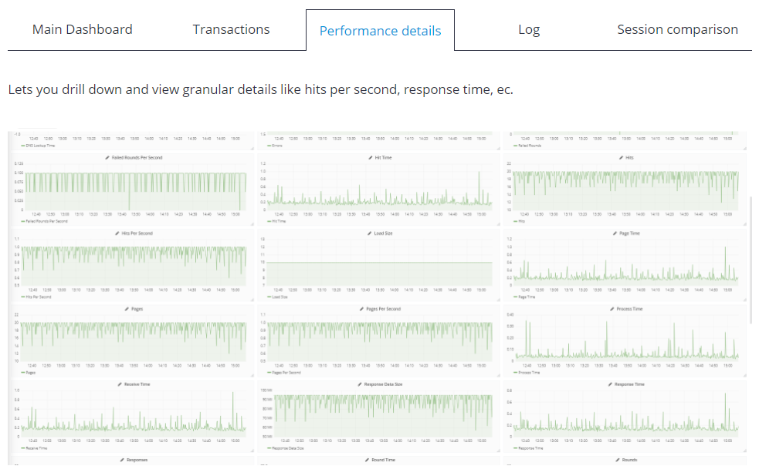

Slide 11
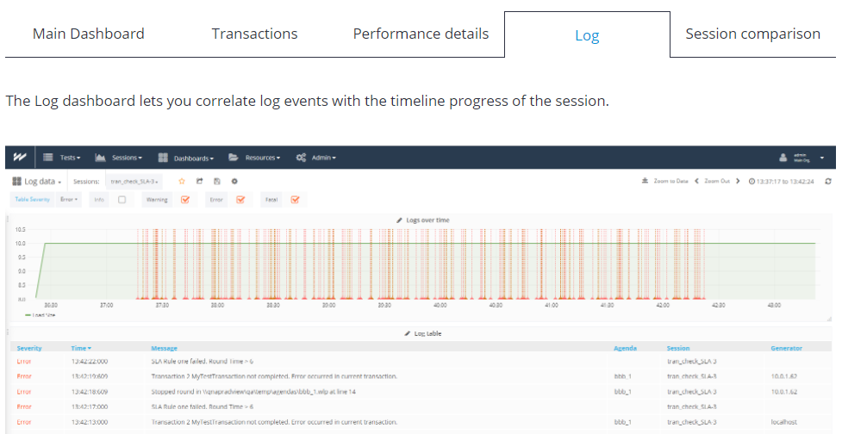

Slide 12
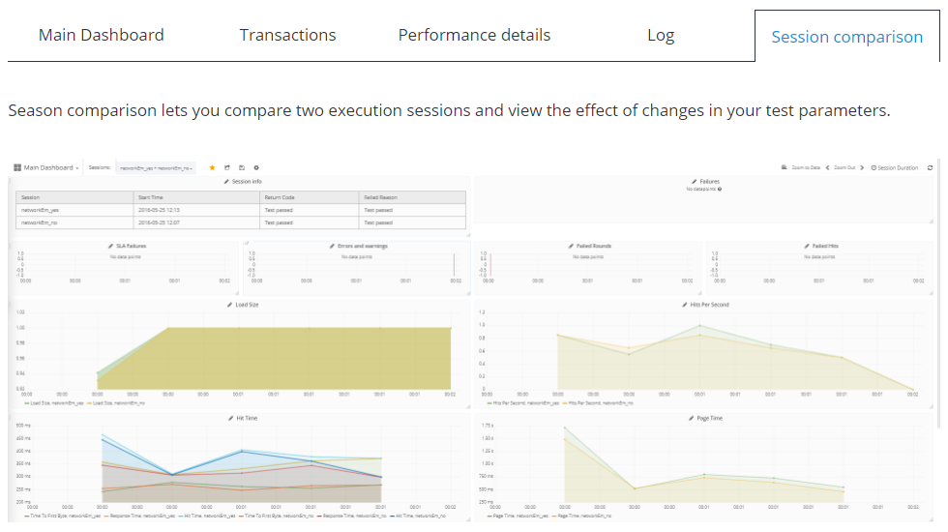

Slide 13
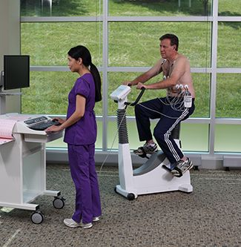
Load & Stress test cases

Slide 14
It is black Friday – 1 Million people trying to login at the same time to our system. test case 1 – connect 5 Million users to the system at the same time.

Slide 15
After a user shopping for 3 hours, power outage was accrued during adding to cart a whole bag in some store. test case 2 – the system shut down in the middle of add to cart function.

Slide 16
It was the national Pi day, and 50% discount on all the Pi cakes in Avi’s store. test case 3 – 100 users trying to buy a specific product from specific store while there is only 5 products available.

Slide 17
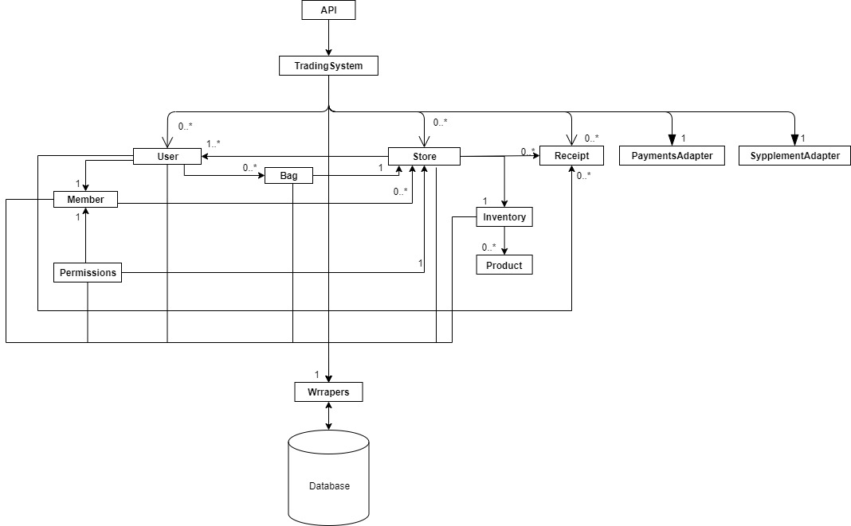

Slide 18
